Slide 1
王喻民(R07921009)、林柏宇(R07921070) Digital Control Systems 2019/6/25
Project Final Report
Simulation Study of Cruise Control

Slide 2

Outline
Introduction
State-Space Model
System Analysis
Controller Design
Conclusion
References
Simulation Study of Cruise Control
王喻民、林柏宇

Slide 3
Introduction
Cruise control system is a system that automatically controls the speed of a vehicle.
There are some advantages of cruise control:
Reducing driver fatigue.
Avoid subconsciously violating speed limits.
Increased fuel efficiency.
Therefore, we decide to implement a simulation of a cruise control system.
Simulation Study of Cruise Control
王喻民、林柏宇

Slide 4
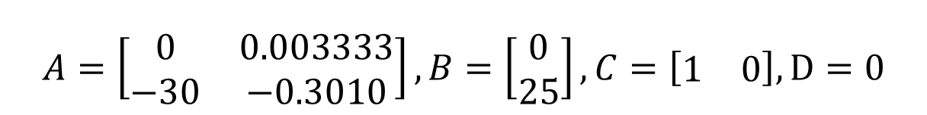
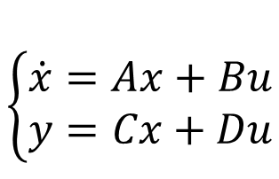
State-Space Model
The continuous-time state-space model (Simplify the model derived in [1: Morand et al. 2016].)
$$\left\{\begin{matrix}\dot{x}=Ax+Bu \\ y=Cx+Du\end{matrix}\right.$$
$$A=\left[\begin{matrix}0 & 0.003333 \\ −30 & −0.3010\end{matrix}\right],B=\left[\begin{matrix}0 \\ 25\end{matrix}\right], C=\left[\begin{matrix}1 & 0\end{matrix}\right],D=0$$
Simulation Study of Cruise Control
王喻民、林柏宇

Slide 5
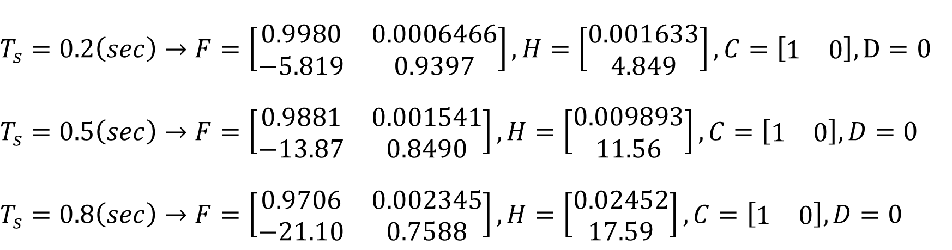
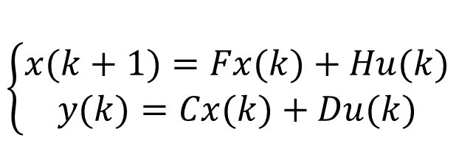
State-Space Model
The discrete-time state-space model (Use Matlab function c2d().)
$$\left\{\begin{matrix}x(k+1)=Fx(k)+Hu(k) \\ y(k)=Cx(k)+Du(k)\end{matrix}\right.$$
$$T_{s}=0.2\left(sec\right)→F=\left[\begin{matrix}0.9980 & 0.0006466 \\ −5.819 & 0.9397\end{matrix}\right],H=\left[\begin{matrix}0.001633 \\ 4.849\end{matrix}\right], C=\left[\begin{matrix}1 & 0\end{matrix}\right],D=0$$
$$T_{s}=0.5\left(sec\right)→F=\left[\begin{matrix}0.9881 & 0.001541 \\ −13.87 & 0.8490\end{matrix}\right],H=\left[\begin{matrix}0.009893 \\ 11.56\end{matrix}\right], C=\left[\begin{matrix}1 & 0\end{matrix}\right],D=0$$
$$T_{s}=0.8\left(sec\right)→F=\left[\begin{matrix}0.9706 & 0.002345 \\ −21.10 & 0.7588\end{matrix}\right],H=\left[\begin{matrix}0.02452 \\ 17.59\end{matrix}\right], C=\left[\begin{matrix}1 & 0\end{matrix}\right],D=0$$
Simulation Study of Cruise Control
王喻民、林柏宇

Slide 6
System Analysis
Step response of the continuous-time system and the discrete-time systems with different sampling times
Simulation Study of Cruise Control
王喻民、林柏宇

Slide 7
System Analysis
Bode diagram of the continuous-time system and the discrete-time systems with different sampling times
Simulation Study of Cruise Control
王喻民、林柏宇

Slide 8
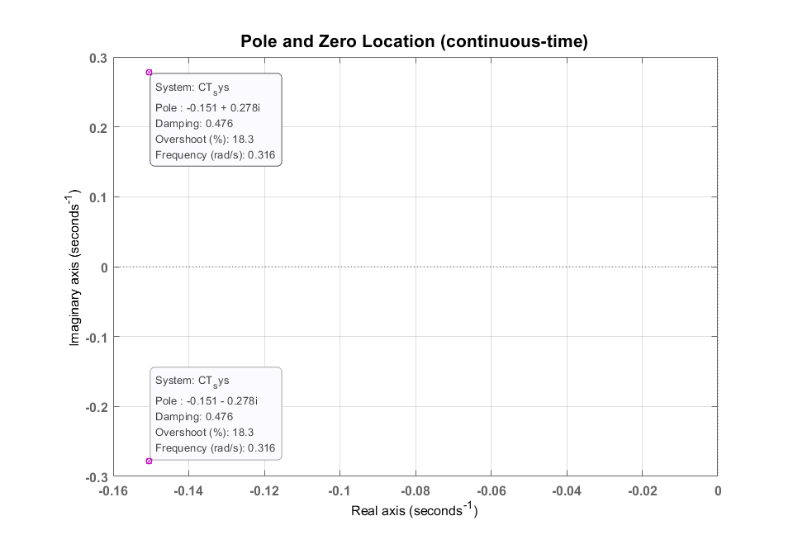
System Analysis
Check the stability of the continuous-time system.
Because the poles are both in the left-half plane, the system is stable.
Simulation Study of Cruise Control
王喻民、林柏宇

Slide 9
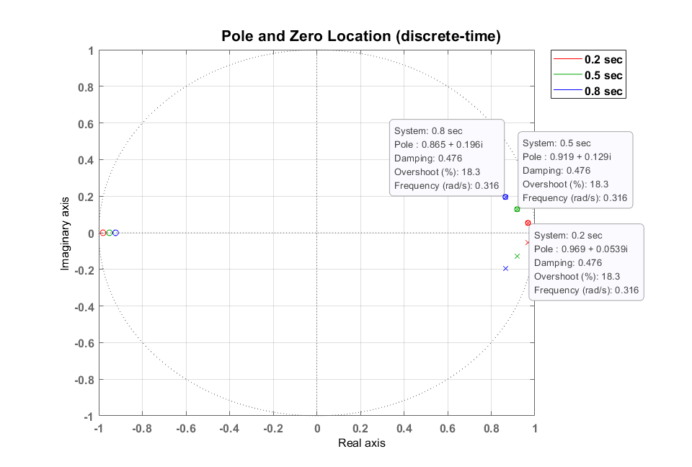
System Analysis
Check the stability of the discrete-time systems with different sampling times.
Because the poles of each system are all in the unit circle, the systems are stable.
Simulation Study of Cruise Control
王喻民、林柏宇

Slide 10
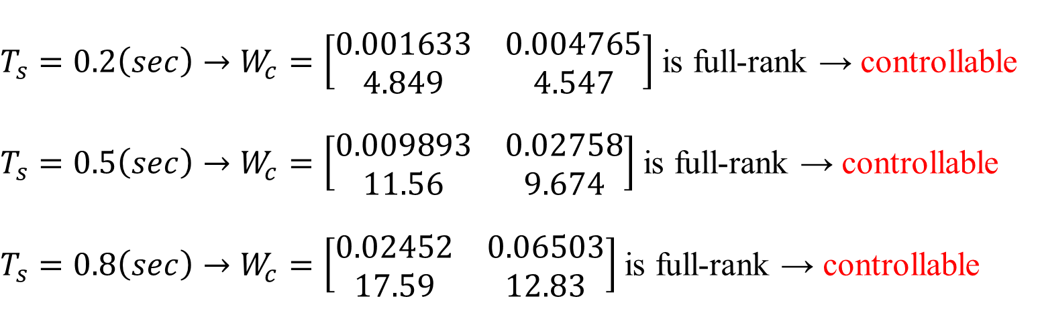
System Analysis
Check the controllability of the discrete-time systems. (Use Matlab function ctrb().)
$T_{s}=0.2\left(sec\right)→W_{c}=\left[\begin{matrix}0.001633 & 0.004765 \\ 4.849 & 4.547\end{matrix}\right]$ is full-rank → controllable
$T_{s}=0.5\left(sec\right)→W_{c}=\left[\begin{matrix}0.009893 & 0.02758 \\ 11.56 & 9.674\end{matrix}\right]$ is full-rank → controllable
$T_{s}=0.8\left(sec\right)→W_{c}=\left[\begin{matrix}0.02452 & 0.06503 \\ 17.59 & 12.83\end{matrix}\right]$ is full-rank → controllable
Simulation Study of Cruise Control
王喻民、林柏宇

Slide 11
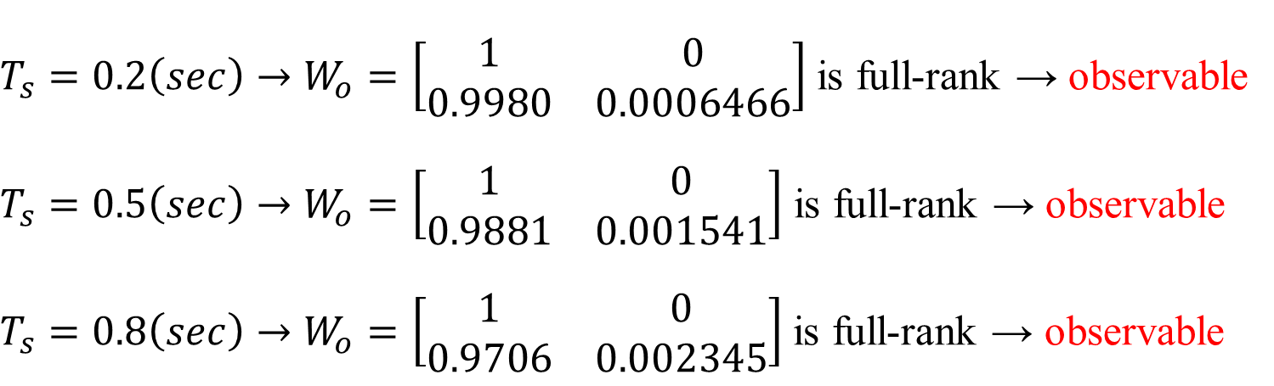
System Analysis
Check the observability of the discrete-time systems. (Use Matlab function obsv().)
$T_{s}=0.2\left(sec\right)→W_{o}=\left[\begin{matrix}1 & 0 \\ 0.9980 & 0.0006466\end{matrix}\right]$ is full-rank → observable
$T_{s}=0.5\left(sec\right)→W_{o}=\left[\begin{matrix}1 & 0 \\ 0.9881 & 0.001541\end{matrix}\right]$ is full-rank → observable
$T_{s}=0.8\left(sec\right)→W_{o}=\left[\begin{matrix}1 & 0 \\ 0.9706 & 0.002345\end{matrix}\right]$ is full-rank → observable
Simulation Study of Cruise Control
王喻民、林柏宇

Slide 12
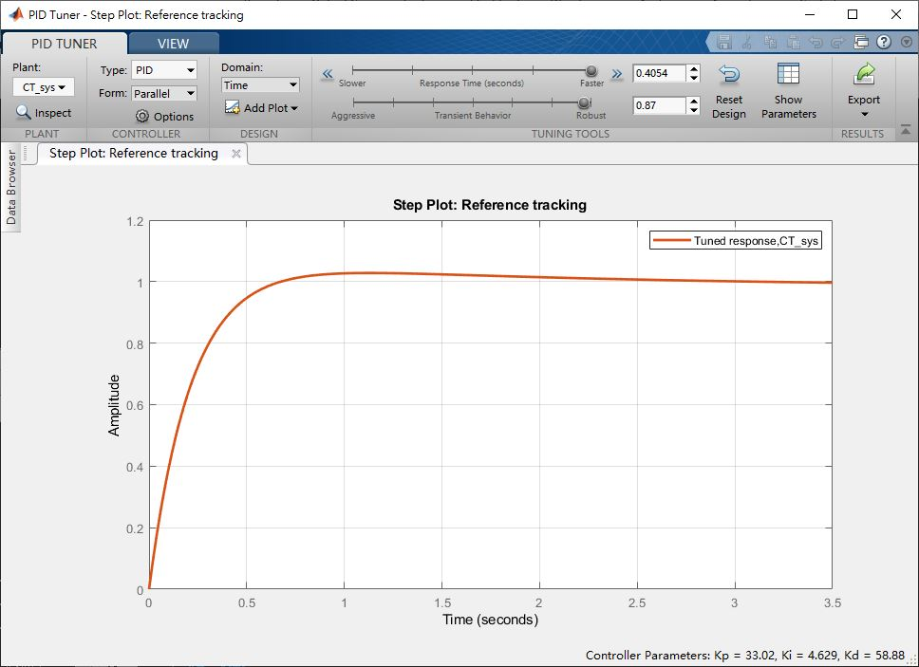
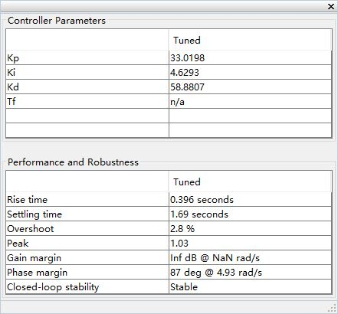
Controller Design
We design a PID controller for the continuous-time system.
Simulation Study of Cruise Control
王喻民、林柏宇

Slide 13
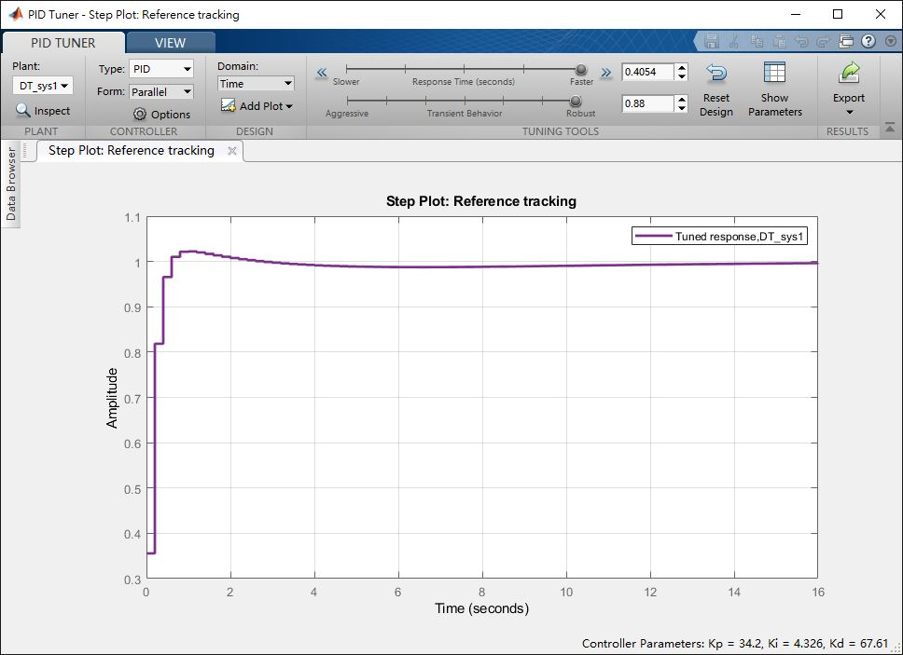
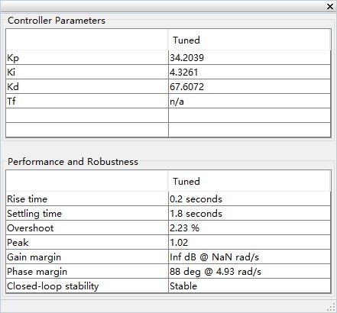
Controller Design
We design a PID controller for the discrete-time system. (0.2 sec)
Simulation Study of Cruise Control
王喻民、林柏宇

Slide 14
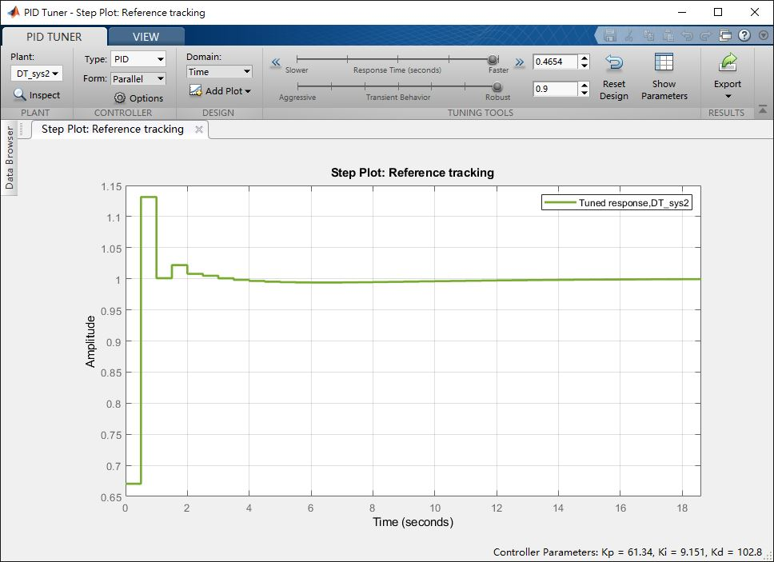
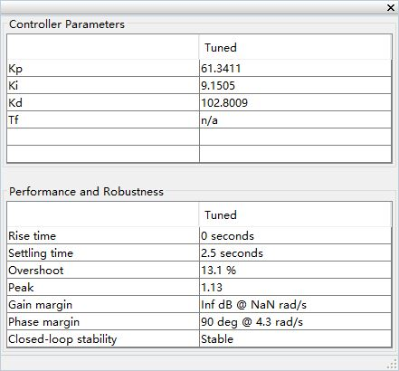
Controller Design
We design a PID controller for the discrete-time system. (0.5 sec)
Simulation Study of Cruise Control
王喻民、林柏宇

Slide 15
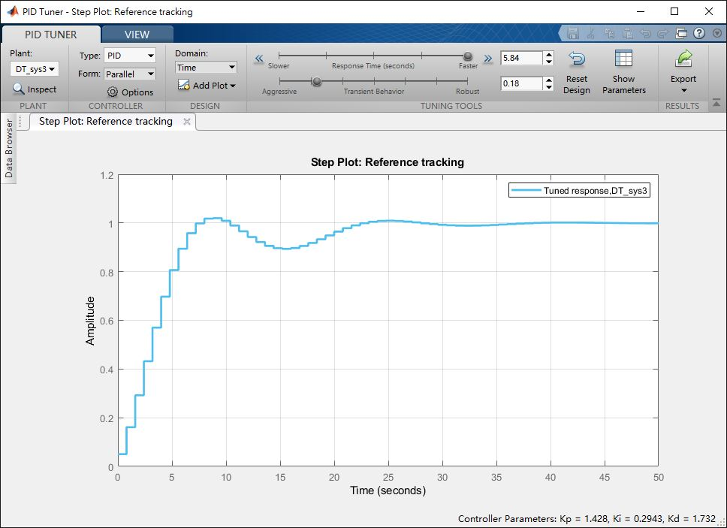
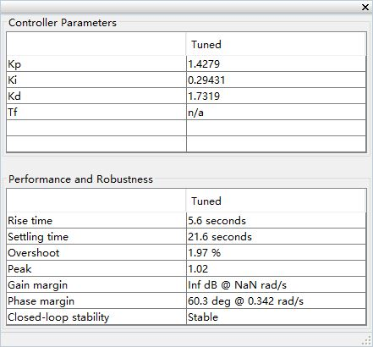
Controller Design
We design a PID controller for the discrete-time system. (0.8 sec)
Simulation Study of Cruise Control
王喻民、林柏宇

Slide 16
Conclusion
As the sampling time larger, it is more difficult to tune the PID gain to satisfy the performance specification for both smaller settling time and smaller overshoot.
Simulation Study of Cruise Control
王喻民、林柏宇

Slide 17
References
[1: Morand et al. 2016]
Audrey Morand, Xavier Moreau, Pierre Melchior, Mathieu Moze, and Frank Guillemard, “CRONE Cruise Control System,” IEEE Transactions on Vehicular Technology, Vol. 65, No. 1, pp. 15-28, January 2016
[2: Espanet et al. 2012]
Christophe Espanet, Frédéric Dubas, Hoang Minh Maï, Didier Chamagne, Robert Bernard, and Pascal Bigot, “In-wheel motor for a small hybrid electric vehicle: design, realization and experimental characterization,” IEEE Energy Conversion Congress and Exposition, pp. 892-898, September 2012
[3: Pacejka and Besselink 1997]
H. B. Pacejka and I. J. M. Besselink, “Magic Formula Tyre Model with Transient Properties,” Vehicle System Dynamics International Journal of Vehicle Mechanics and Mobility, Vol. 27, No. S1, pp. 234-249, August 1997
[4: Molnár et al. 2018]
Tamás G. Molnár, Wubing B. Qin, Tamás Insperger, and Gábor Orosz, “Application of Predictor Feedback to Compensate Time Delays in Connected Cruise Control,” IEEE Transactions on Intelligent Transportation Systems, Vol. 19, No. 2, pp. 545-559, February 2018
Simulation Study of Cruise Control
王喻民、林柏宇

Slide 18
References
[5: Zhang and Orosz 2016]
Linjun Zhang and Gábor Orosz, “Motif-Based Design for Connected Vehicle Systems in Presence of Heterogeneous Connectivity Structures and Time Delays,” IEEE Transactions on Intelligent Transportation Systems, Vol. 17, No. 6, pp. 1638-1651, June 2016
[6: Ploeg et al. 2014]
Jeroen Ploeg, Dipan P. Shukla, Nathan van de Wouw, and Henk Nijmeijer, “Controller Synthesis for String Stability of Vehicle Platoons,” IEEE Transactions on Intelligent Transportation Systems, Vol. 15, No. 2, pp. 854-865, April 2014
[7: Stépán 2001]
Gábor Stépán, “Vibrations of Machines Subjected to Digital Force Control,” International Journal of Solids and Structures, Vol. 38, No. 10-13, pp. 2149-2159, March 2001
[8: Qin and Orosz 2013]
Wubing B. Qin and Gábor Orosz, “Digital Effects and Delays in Connected Vehicles: Linear Stability and Simulations,” ASME 2013 Dynamic Systems and Control Conference, pp. V002T30A001, October 2013
Simulation Study of Cruise Control
王喻民、林柏宇

